Slide 1

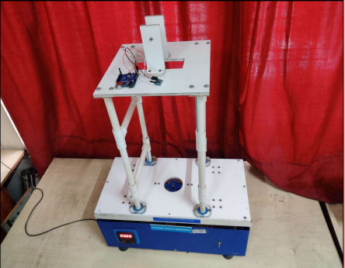
MODERN EDUCATION SOCIETY’S COLLEGE OF ENGINEERING, PUNE
DEPARTMENT OF MECHANICAL ENGINEERING
B.E PROJECT POSTER PRESENTATION 2022-2023 DATE -
Research and Analysis
Design Of Test Rig For Dynamic Shock Absorber Using Spring Mass System
Project Guide
Prof. Suhas S. Jadhav
1)Somnath Sapkal 2)Sanat Sarang
3)Tejas Khatpe 4)Gopal Chavan
ABSTRACT
METHODOLOGY / EXPERIMENTAL SETUP
CONCLUSION AND FUTURE SCOPE
The aim of this project is to design and develop a test rig for a dynamic shock absorber using a spring mass system. The test rig is intended to simulate the conditions that a shock absorber would experience in real-world scenarios. The project involves the design and fabrication of the test rig, selection of appropriate materials, and selection of suitable parameters for the spring and mass system.
The test rig will be capable of measuring the damping coefficient of the shock absorber under various conditions.
Aim : To improve the vibration control of structures using TMD
In these we studied about the tune mass damper. It’s advantages and disadvantages . It’s application in our daily life . To design the test rig for dynamic shock absorber. To design the test rig for dynamic shock absorption. We learnt about the spring mass system.
In the future, there are several potential areas where the TMD can be applied:
Offshore Structures: TMDs can be installed on offshore structures, such as oil rigs or wind turbines, to reduce the effects of wave loads. This can help to improve the safety and reliability of these structures.
Seismic Retrofitting: TMDs can be used in the seismic retrofitting of existing buildings and structures to reduce the effects of earthquakes. This can help to improve the safety of these structures and reduce damage during seismic events.
Aerospace Applications: TMDs can be used in aerospace applications to reduce the vibrations caused by engine and aerodynamic loads. This can help to improve the comfort and safety of passengers and crew.
Study of Vibration
Define Problem Statement of Tuned Mass Damper
Literature Survey
Design and settling the parameter values of TMD
Analysis of System to External Force Without TMD
Analysis of System to External Force With TMD
Finding and checking the correction of the Parameter with a motion of structure
Result and Conclusion
LITERATURE REVIEW
FINDINGS / RESULTS & DISCUSSIONS
REFERENCES
1)Abdulsalam I, Al-Janabi M, Al-Taweel MG. Optimum design of tuned mass damper systems for seismic structures. In7th International Conference on Earthquake Resistant Engineering Structures 2009 Apr 23 (Vol. 104, pp. 175-184). In these we studied about the Tuned mass dampers are well known devices for the passive control of vibrations in buildings subjected to earthquake loadings.
2)Deore KS, Talikoti RS, Tolani KK. Vibration analysis of structure using tune mass damper. Int. Res. J. Eng. Technol.(IRJET). 2017;4(7):2814-20. In these we studied about Current trends in construction industry demands taller and lighter structures, which are also more flexible and having quite low damping value.
Without spring mass system the vibration of the system was higher when the spring mass system was attached the vibration of the system was decreased that is they were damped.
1.Abdulsalam I, Al-Janabi M, Al-Taweel MG. Optimum design of tuned mass damper systems for seismic structures. In7th International Conference on Earthquake Resistant Engineering Structures 2009 Apr 23 (Vol. 104, pp. 175- 184). 2.Deore KS, Talikoti RS, Tolani KK. Vibration analysis of structure using tune mass damper. Int. Res. J. Eng. Technol.(IRJET). 2017;4(7):2814-20

